Slide 1
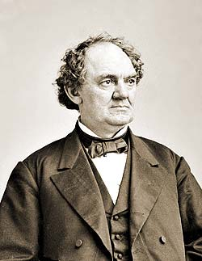
Prince of Humbug
Phineas Taylor Barnum
(1810–1891)
"There’s a sucker born every minute“
[attributed to P.T. Barnum]

Slide 2
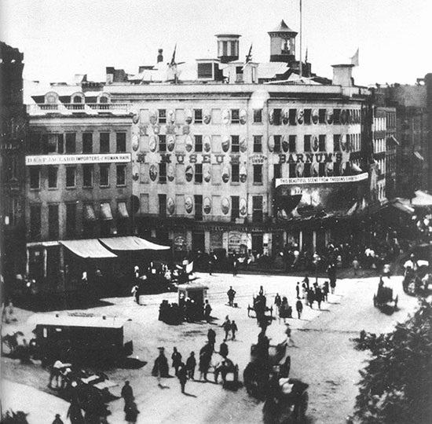
Barnum’s Museum in NY, 1859
burned in 1865

Slide 3
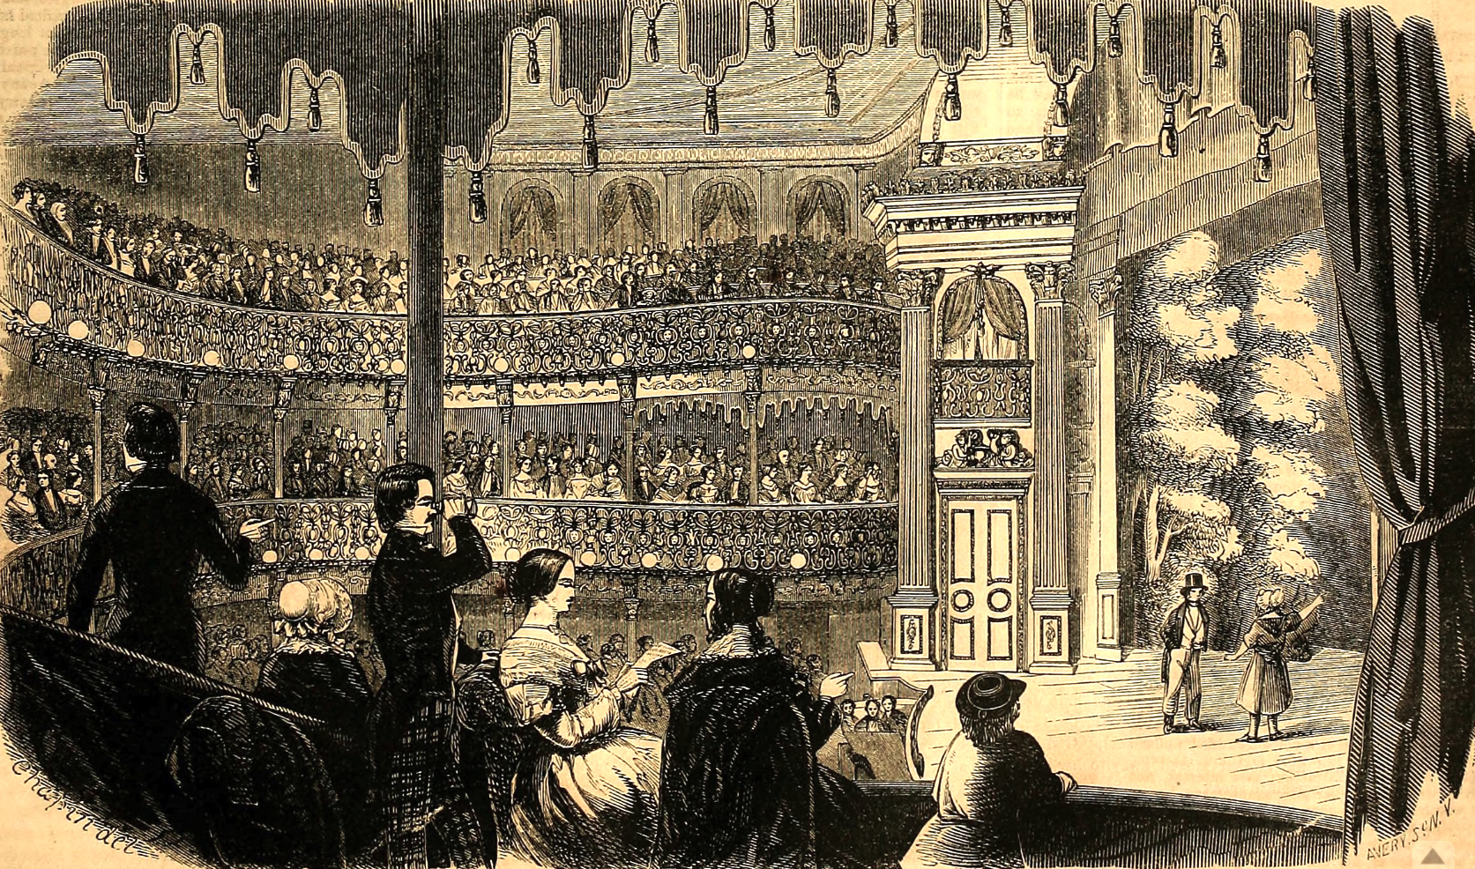

Slide 4
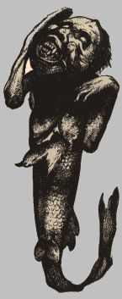
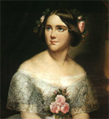
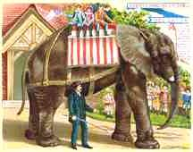
Great Model of Niagara Falls with Real Water
Jenny Lind
Fiji Mermaid
Jumbo the Elephant

Slide 5
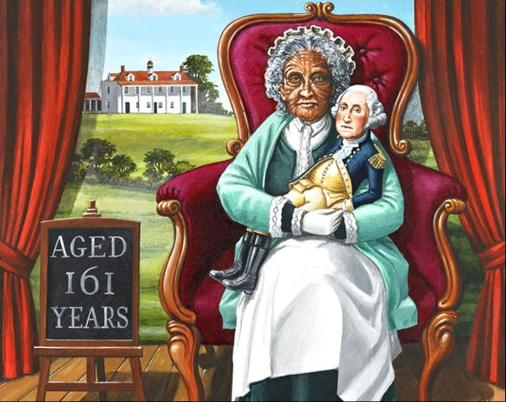
Methuselah was 969 years old when he died, but nothing is said of the age of his wife. Adam attained nearly the age of his antiquated descendant. It is not unlikely that the sex in the olden time were like their daughters at the present day--unwilling to tell their age. Joice Heth is an exception; she comes out boldly, and says she is rising 160. [from an advertisement]

Slide 6
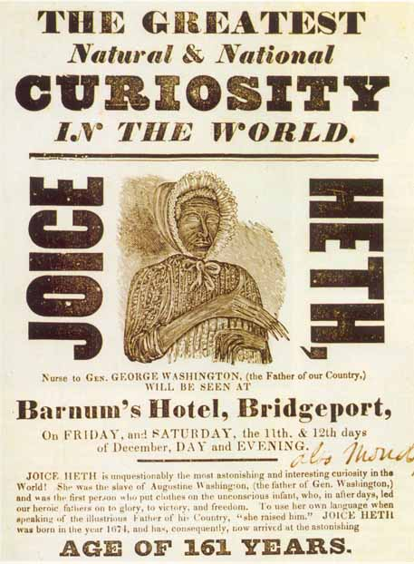
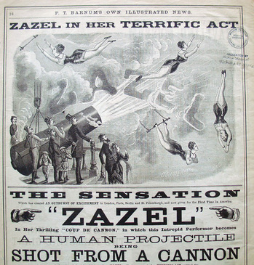
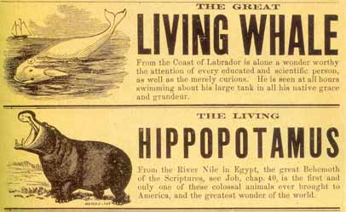

Slide 7
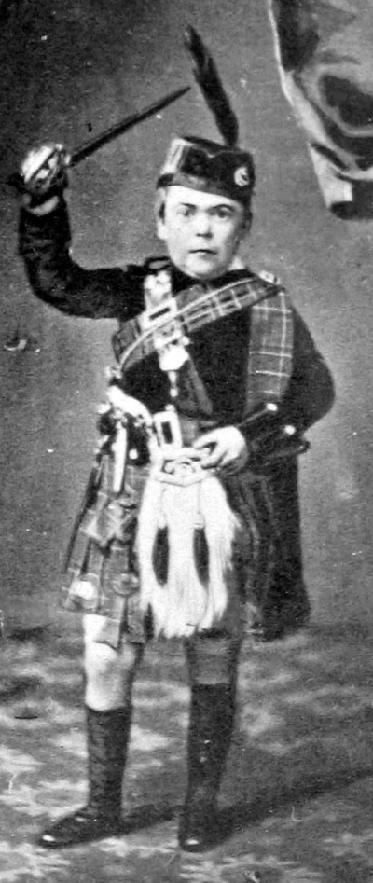
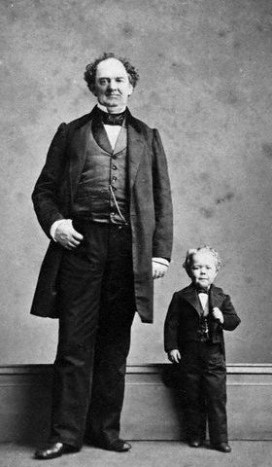
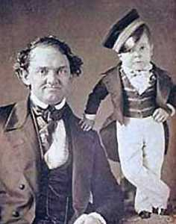
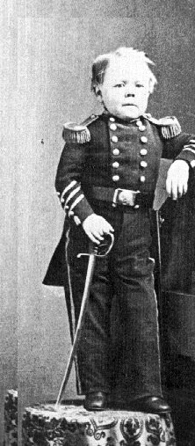
General Tom Thumb
(Charles Sherwood Stratton)

Slide 8
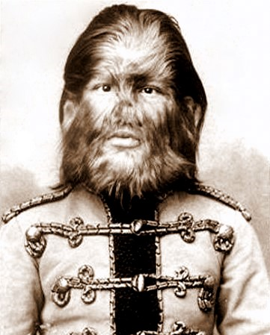
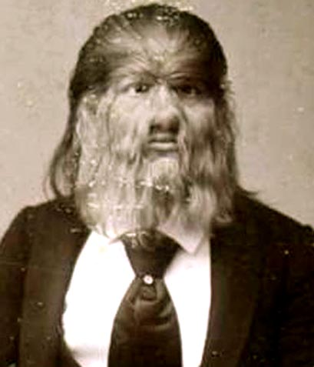
Jo-Jo the Dog-Faced Boy
Fedor Jeftichew

Slide 9
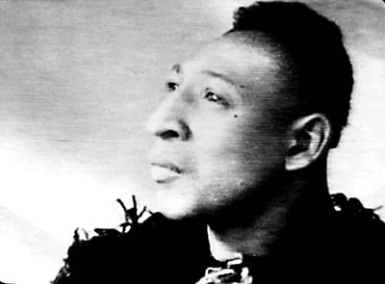
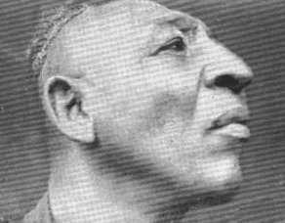
Zip the Pinhead
William Henry Johnson

Slide 10
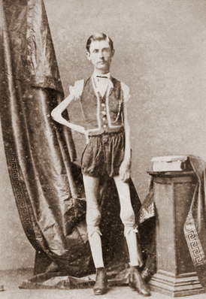
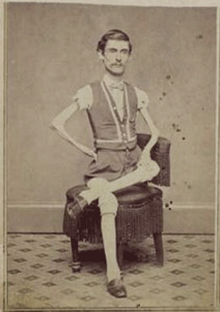
The Living Skeleton
Isaac W. Sprague

Slide 11
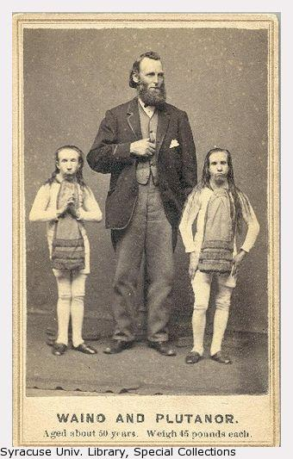
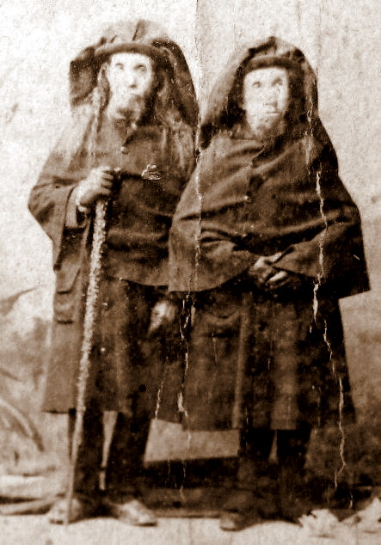
Wild Men of Borneo

Slide 12
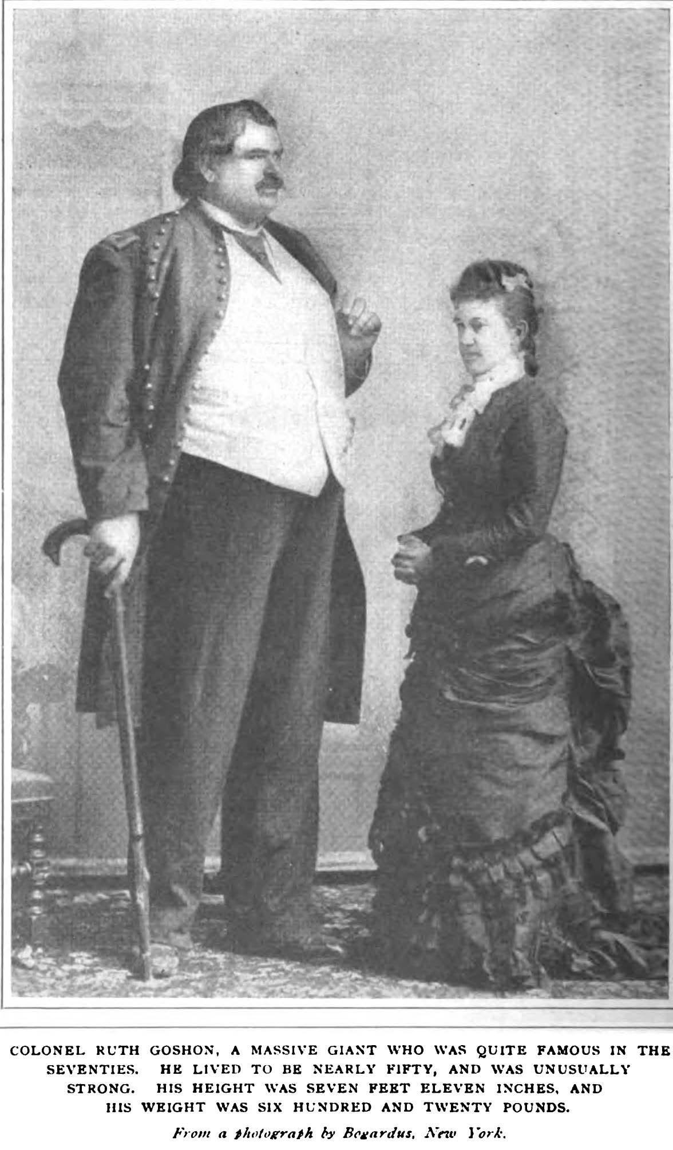
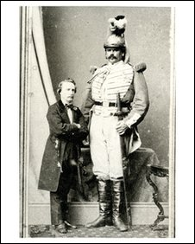
Middlebush Giant

Slide 13
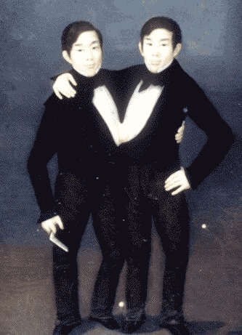
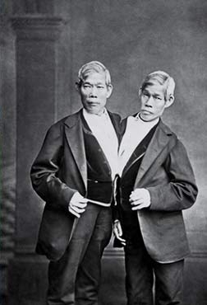
Chang and Eng Bunker
(conjoined twin brothers)

Slide 14
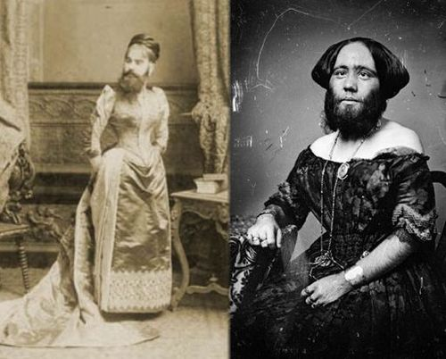
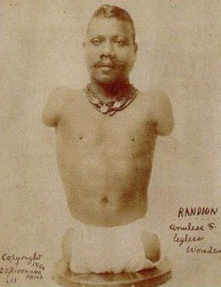
The Bearded Lady of Geneva
Josephine Clofullia
The Human Caterpillar
Prince Randian

Slide 15
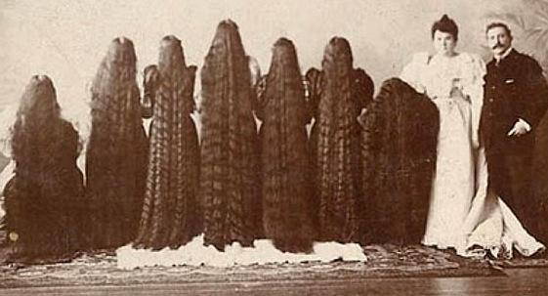
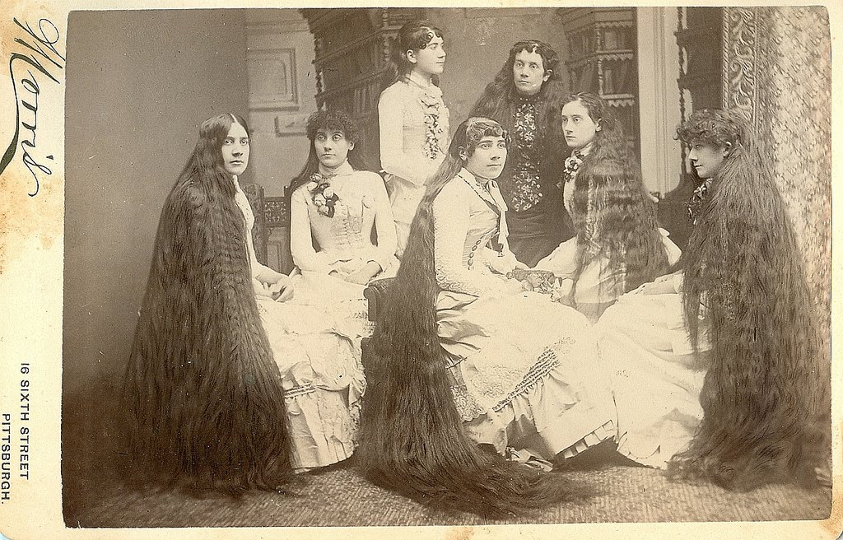
Seven Sutherland Sisters
“The seven most pleasing wonders of the world”

Slide 16
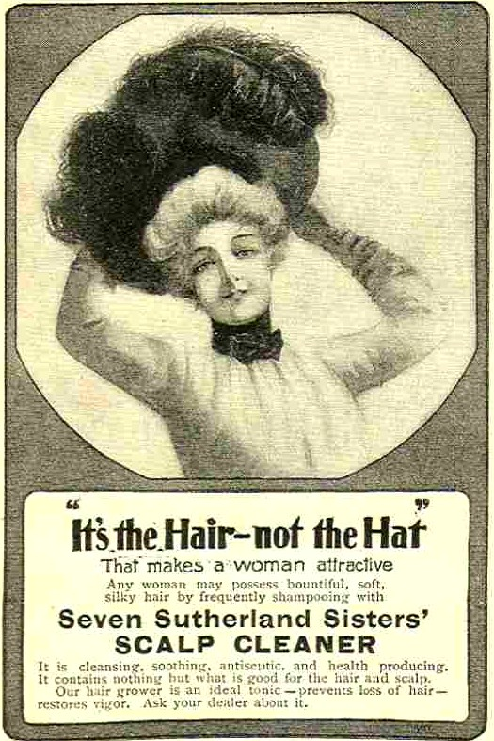
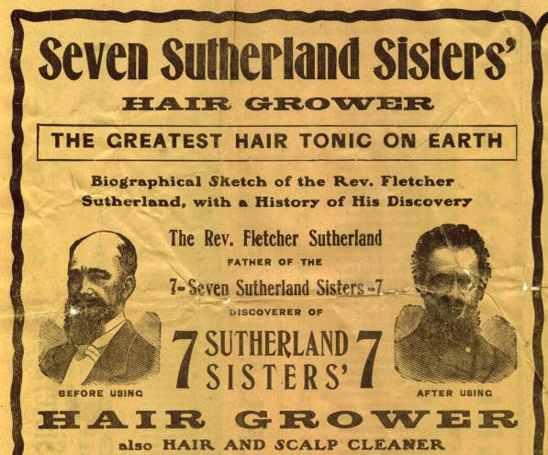

Slide 17
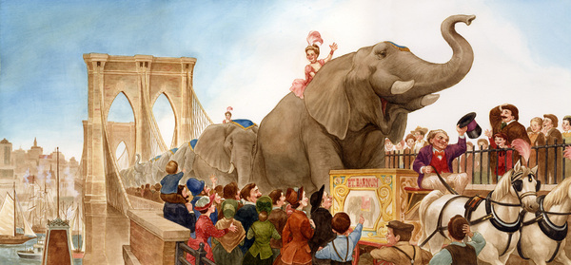
21 elephants’ parade across the Brooklyn Bridge (1883)

Slide 18
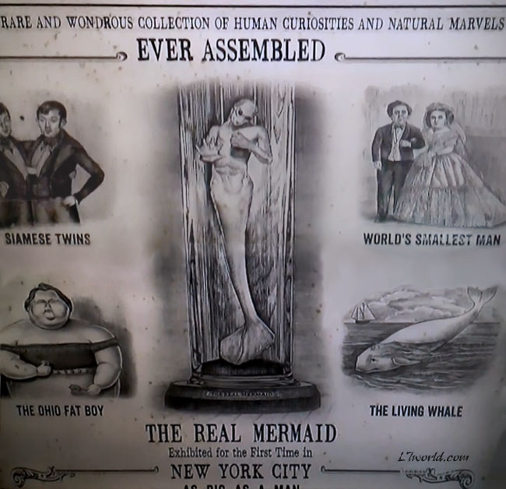

Slide 19
